Slide 1
Modeling Combinational Circuits Hierarchical Design

Slide 2
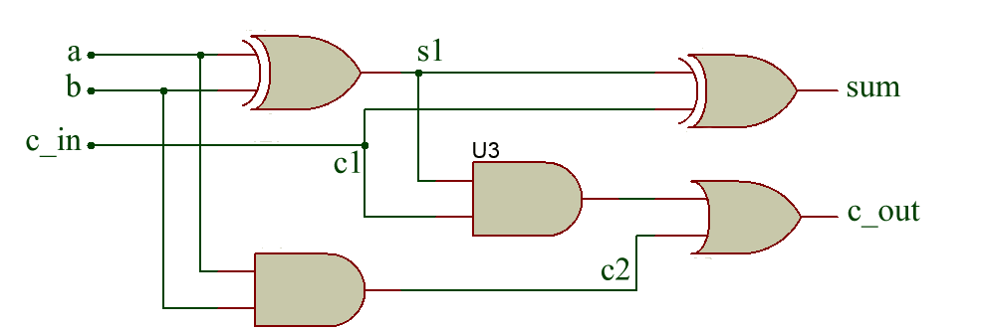
1-bit Ripple Carry Full Adder

Slide 3
1-bit Ripple Carry Full Adder (Gate-Level Modeling)
module OneBitFA (sum, c_out, a, b, c_in);
output sum, c_out;
input a, b, c_in; // I/O Port declaration
wire s1, c1, c2; // Internal nets
xor (s1,a,b);
and (c1,a,b);
xor (sum,s1,c_in);
and (c2,s1,c_in);
or (c_out,c2,c1);
endmodule

Slide 4
Instantiation & Connecting Ports
Connecting ports by ordered list
The signals to be connected must appear in the module instantiation in the same order as the ports in the port list in the module definition.
e.g. > OneBitFA fa0(sum, c_out, A, B, c_in);
Connecting ports by name
For large designs where modules have 50 ports remembering the order of ports is error prone. So connection by name comes in handy.
e.g. > OneBitFA fa1(.c_out(c1), .c_in(c0), .sum(Sum), .a(A), .b(B));
Unconnected ports
Verilog allows ports to remain unconnected. You might not be interested in connecting some port to external signals.
e.g. > OneBitFA fa2(sum, , A, B, c_in)
e.g. > OneBitFA fa3(.c_in(c0), .sum(Sum), .a(A), .b(B));
// In both examples output port c_out is unconnected.

Slide 5
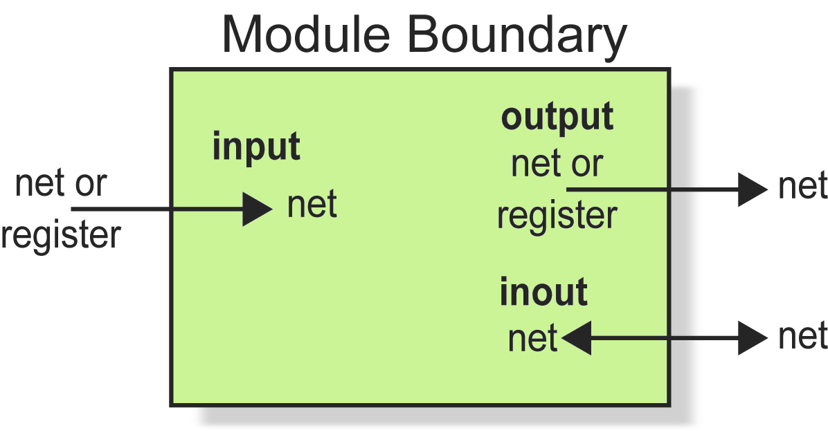
Module Ports

Slide 6
Example 4-bit Ripple Carry Adder
1-bit FA
1-bit FA
1-bit FA
1-bit FA
b₃
a₃
b₂
a₂
b₁
a₁
b₀
a₀
c_{out}
c₃
c₂
c₁
c_{in}
s₃
s₂
s₁
s₀

Slide 7
4-bit Ripple Carry Adder
XOR, AND, OR Gates
1-bit FA #4
XOR, AND, OR Gates
1-bit FA #3
XOR, AND, OR Gates
1-bit FA #2
XOR, AND, OR Gates
1-bit FA #1

Slide 8
Top Level Module (4-bit FA)
module FourBitFA(sum,c_out,a,b,c_in);
output [3:0] sum;
output c_out;
input [3:0] a, b;
input c_in; // I/O port declaration
wire c1,c2,c3; // internal nets
OneBitFA fa0(sum[0],c1,a[0],b[0],c_in);
OneBitFA fa1(sum[1],c2,a[1],b[1],c1);
OneBitFA fa2(sum[2],c3,a[2],b[2],c2);
OneBitFA fa3(sum[3],c_out,a[3],b[3],c3);
// Instantiate four 1-bit full adders
endmodule

Slide 9
Test Bench (stimulus) (Optional)
// define stimulus top-level module
module stimulus;
reg [3:0] a,b; // set up variables
reg c_in;
wire [3:0] sum;
wire c_out;
/* Instantiate the top-level module FourBitFA and call it my_FA */
FourBitFA my_FA(sum,c_out,a,b,c_in);

Slide 10
// stimulate inputs
initial
begin
a = 4'b0000; b = 4'b0010; c_in = 1'b0;
#1 $display (“ a = %b, b = %b, c_in = %b, sum = %b", a, b, c_in, sum);
a = 4'd1; b = 4'd2; c_in = 1'b1;
#2$display (“ a = %b, b = %b, c_in = %b, sum = %b", a, b, c_in, sum);
a = 4'hf; b = 4'ha; c_in = 1'b0;
#2$display (“ a = %b, b = %b, c_in = %b, sum = %b", a, b, c_in, sum);
end
endmodule

Slide 11
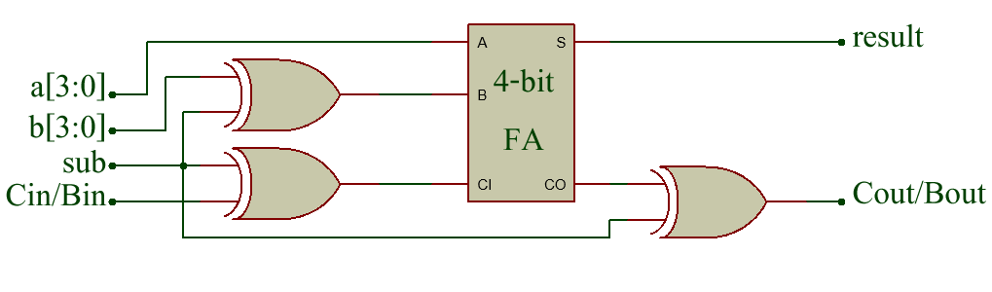
4-bit Adder/Subtracter

Slide 12
4-bit Adder/Subtracter (Gate-Level Modeling)
module AddSub(a, b, Cin_Bin, sub, result, Cout_Bout);
input [3:0] a, b;
input Cin_Bin, sub;
output [3:0] result;
output Cout_Bout;
wire B, CI, CO;
xor x1(B, b, sub); // Bitwise XOR
xor x2(CI, Cin_Bin, sub);
FourBitFA adder(result, CO, a, B, CI);
xor x3(Cout_Bout, CO, sub);
endmodule

